Slide 1

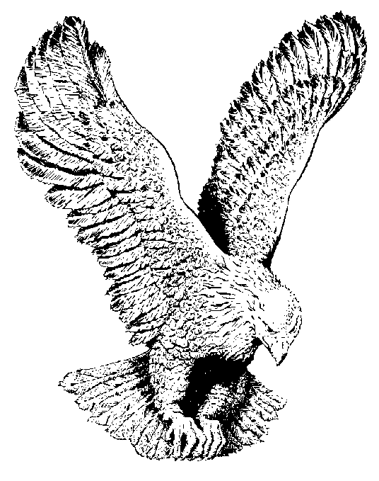
18
ONWARD CHRISTIAN SOLDIERS
Onward, Christian soldiers!
Marching as to war,
With the cross of Jesus
Going on before;
Christ, the royal Master,
Leads against the foe;
Forward into battle,
See, His banners go!

Slide 2
CHORUS
Onward, Christian soldiers!
Marching as to war,
With the cross of Jesus
Going on before.

Slide 3
Like a mighty army
Moves the Church of God;
Brothers, we are treading
Where the saints have trod;
We are not divided,
All one body we;
One in hope and doctrine,
One in charity.

Slide 4
Crowns and thornes may perish,
Kingdoms rise and wane;
But the Church of Jesus
Constant will remain;
Gates of hell can never
‘Gainst that Church prevail;
We have Christ’s own promise,
Which can never fail.

Slide 5
At the sign of triumph,
Satan’s host doth flee;
Oh, then, Christian soldiers,
On to victory!
Hell’s foundations quiver
At the shout of praise;
Brothers, lift your voices,,
Loud your anthems raise!

Slide 6
Onward, then ye people!
Join our happy throng;
Blend with ours your voices
In the triumph song;
Glory, laud, and honor,
Unto Christ the King;
This through countless ages
Men and angels sing.

